Slide 1
CONCEPTS OF ECONOMICS · CHAPTER 04
Theory of Consumer Behaviour
Utility Theory · Diminishing Marginal Utility · The Equi-Marginal Principle
Lecture 07 & 08

Slide 2
SESSION ROADMAP
Four Ideas, One Consumer Decision
01
Utility Theory
How economists measure the satisfaction consumers get from goods and services.
02
Diminishing Marginal Utility
Why each extra unit consumed adds less satisfaction than the one before.
03
The Diamond–Water Paradox
Why essentials can be cheap and non-essentials expensive — solved by marginal, not total, utility.
04
Equi-Marginal Utility
How a rational consumer allocates a limited budget across many goods.
THEORY OF CONSUMER BEHAVIOUR | CONCEPTS OF ECONOMICS
1

Slide 3
WARM-UP · EVERYDAY ECONOMICS
Do We Use Economics Every Day?
Think about the last time you were thirsty.
1
After how many glasses of water is your thirst fully satisfied?
2
If you drink one glass more than that, how does it make you feel?
3
How do you decide when to stop drinking — what's guiding that choice?
You've just answered using the logic of utility — without ever using the word.
THEORY OF CONSUMER BEHAVIOUR | CONCEPTS OF ECONOMICS
2

Slide 4
UTILITY THEORY · FOUNDATIONS
Three Terms You Need First
1
2
3
Utility
Utility Analysis
Util
The want-satisfying power of a good or service — what it does for the consumer, not what it costs.
The study of consumer decision-making, built on the assumption that consumers act to maximize utility.
A representative, notional unit used to measure and compare utility across goods.
THEORY OF CONSUMER BEHAVIOUR | CONCEPTS OF ECONOMICS
3

Slide 5
UTILITY THEORY · CORE CONCEPT
Total Utility vs. Marginal Utility
Total Utility (TU)
Marginal Utility (MU)
The sum total of satisfaction a consumer receives from consuming all units of a commodity put together.
The change in total utility caused by consuming one additional unit of a good or service.
MU =
Change in Total Utility
Change in No. of Units Consumed
Answers: “How satisfied am I overall?”
THEORY OF CONSUMER BEHAVIOUR | CONCEPTS OF ECONOMICS
4

Slide 6
UTILITY THEORY · WORKED CALCULATION
Marginal Utility from Consuming Apples
Units Consumed | Total Utility (TU) | Marginal Utility (MU)
1 | 7 | 7
2 | 13 | 6
3 | 18 | 5
4 | 22 | 4
5 | 25 | 3
6 | 27 | 2
7 | 28 | 1
8 | 28 | 0
Reading the Table
Each extra apple raises Total Utility by a smaller amount than the one before.
Marginal Utility falls steadily: 7 → 6 → 5 → 4 … → 0.
At the 8th apple, MU = 0 — the consumer is completely satiated.
5

Slide 7
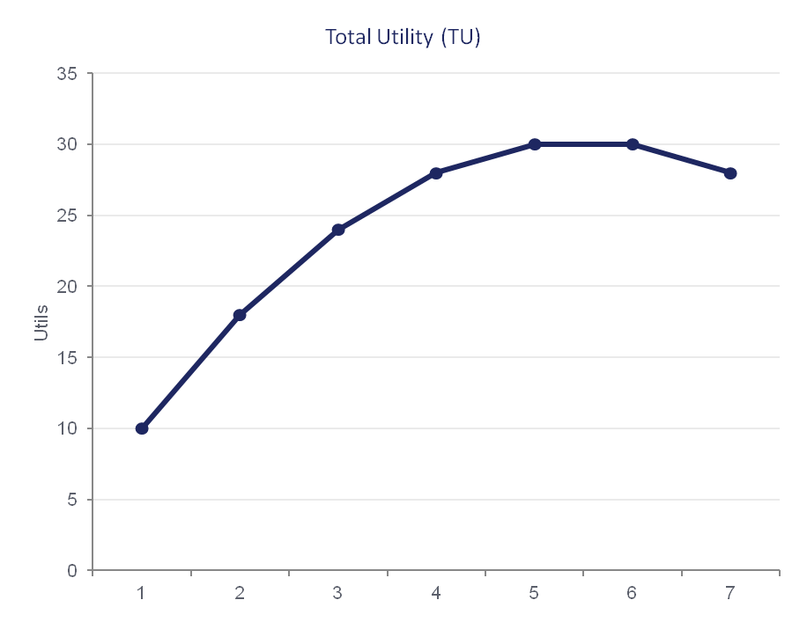
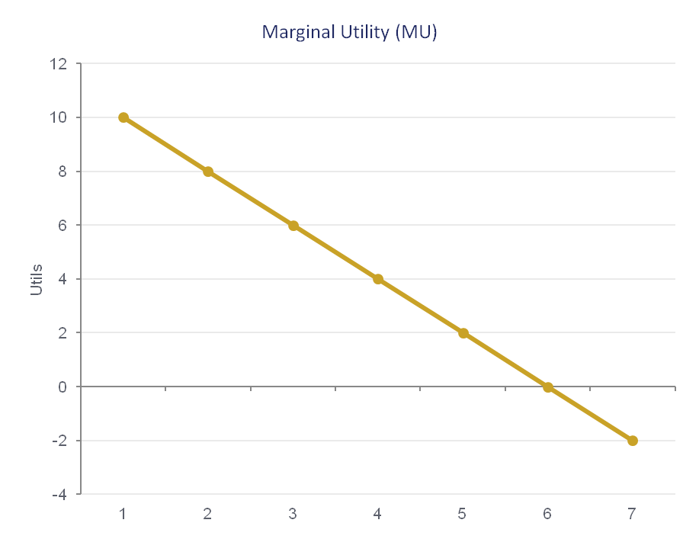
UTILITY THEORY · VISUALIZING THE RELATIONSHIP
Total Utility Peaks Where Marginal Utility Is Zero
Total Utility is maximized exactly where Marginal Utility crosses zero — beyond that point, extra consumption reduces total satisfaction.
THEORY OF CONSUMER BEHAVIOUR | CONCEPTS OF ECONOMICS
6

Slide 8
DIMINISHING MARGINAL UTILITY
The Law of Diminishing Marginal Utility
As a consumer acquires more units of a good, the additional (marginal) utility from each successive unit tends to decline — holding all else constant.
Why It Happens
Each unit satisfies a slightly less urgent want than the one before it.
The consumer's capacity to enjoy or use the good is biologically or practically limited.
Beyond a point, an extra unit can even reduce satisfaction — shown by negative MU in row 7 above.
Qty | Total Utility | Marginal Utility
1 | 30 | 30
2 | 55 | 25
3 | 75 | 20
4 | 90 | 15
5 | 98 | 8
6 | 100 | 2
7 | 98 | -2
THEORY OF CONSUMER BEHAVIOUR | CONCEPTS OF ECONOMICS
7

Slide 9
REAL-WORLD CASE · 2026
Diminishing Marginal Utility, One Upgrade at a Time
Why Upgrade Cycles Keep Stretching
~4 yrs
Successive phone generations deliver smaller, less noticeable improvements — the jump from good to great feels far smaller than good-enough to good once was.
In marginal-utility terms: each new model still adds utility, but the additional (marginal) satisfaction from upgrading keeps shrinking.
As MU from a new phone approaches the MU obtainable from spending that money elsewhere, consumers rationally delay the purchase.
Result: premium U.S. owners now hold devices ≈42 months on average — rising component costs reinforce the same decision.
projected global smartphone replacement cycle in 2026, up from 3.5 years in 2025
Source: Counterpoint Research, via TechCrunch (Aug 2026)
THEORY OF CONSUMER BEHAVIOUR | CONCEPTS OF ECONOMICS
8

Slide 10
THE DIAMOND–WATER PARADOX
An Essential Good, Priced Near Zero
A puzzle first posed by Adam Smith:
WATER
DIAMONDS
Essential for survival. Extremely cheap.
Not essential for survival. Extremely expensive.
Core question: why is something essential valued (priced) less than something non-essential?
THEORY OF CONSUMER BEHAVIOUR | CONCEPTS OF ECONOMICS
9

Slide 11
SOLVING THE PARADOX
Marginal Utility, Not Total Utility, Sets Price
 | Water | Diamonds
Total Utility | High — essential for life | Low — not essential
Abundance | Very abundant | Very scarce
Marginal Utility | Low — one more glass adds little | High — one more carat adds a lot
Market Price | Low | High
Water's abundance keeps its marginal utility — and price — low, even though its total utility is enormous. Diamonds are scarce, so even a small quantity carries high marginal utility, and a high price.
THEORY OF CONSUMER BEHAVIOUR | CONCEPTS OF ECONOMICS
10

Slide 12
MARGINAL UTILITY THEORY
Prices Track the Margin, Not the Whole
Abundance → Low MU
Scarcity → High MU
Price Follows MU
When supply of a good is plentiful relative to demand, each additional unit satisfies a less urgent want — marginal utility falls.
When supply is limited relative to demand, each additional unit is highly valued — marginal utility stays high.
Because buyers pay for the value of the next unit — not the sum of all units already enjoyed — price tracks marginal, not total, utility.
Conclusion: prices reflect the marginal benefit of one more unit — not a good's overall usefulness to humanity.
THEORY OF CONSUMER BEHAVIOUR | CONCEPTS OF ECONOMICS
11

Slide 13
REAL-WORLD CASE · THE PARADOX, UPDATED
When Water Stops Being Abundant, Its Price Moves
Scarcity Turns Water Into a Priced, Traded Asset
NQH2O
In water-stressed regions like California, water rights now trade like a commodity — farmers, cities, and investors hedge against scarcity using water futures.
As climate change and drought shrink the abundant supply the paradox assumed, water's marginal utility — and price — rises toward levels once reserved for scarce goods.
This is the diamond-water paradox running in reverse: remove abundance, and marginal utility (and price) respond exactly as the theory predicts.
the Nasdaq Veles California Water Index, traded on CME as futures since Dec 2020
Source: CME Group / Nasdaq
THEORY OF CONSUMER BEHAVIOUR | CONCEPTS OF ECONOMICS
12

Slide 14
EQUI-MARGINAL UTILITY
The Law of Equi-Marginal Utility
“If a person has a thing which he can put to several uses, he will distribute it among these uses in such a way that it has the same marginal utility in all.”
=
⋯
MU of Good A
Price of Good A
MU of Good B
Price of Good B
MU of Good Z
Price of Good Z
In plain terms: allocate your last rupee so it buys the same extra satisfaction no matter which good it's spent on.
THEORY OF CONSUMER BEHAVIOUR | CONCEPTS OF ECONOMICS
13

Slide 15
EQUI-MARGINAL UTILITY · WORKED EXAMPLE
Allocating ₹17 Between Apples and Oranges
Apple = ₹2/unit · Orange = ₹1/unit · Income = ₹17
Apples
Oranges (selected quantities)
Qty | TU | MU | MU/P
1 | 20 | 20 | 10
2 | 36 | 16 | 8
3 | 48 | 12 | 6
4 | 56 | 8 | 4
Qty | TU | MU | MU/P
1 | 12 | 12 | 12
4 | 42 | 9 | 9
7 | 63 | 6 | 6
9 | 72 | 4 | 4
Optimum: 4 apples (₹8) + 9 oranges (₹9) = ₹17 spent in full, with MUₐ/Pₐ = MUₒ/Pₒ = 4 utils per rupee — the highest attainable total utility (128 utils) for this budget.
THEORY OF CONSUMER BEHAVIOUR | CONCEPTS OF ECONOMICS
14

Slide 16
EQUI-MARGINAL UTILITY · COMPARATIVE STATICS
How a Price Change Shifts the Optimum
BEFORE
AFTER A PRICE FALL (Orange)
MUₐ/Pₐ = MUₒ/Pₒ
MUₒ/Pₒ > MUₐ/Pₐ
Budget optimally split — the last rupee buys equal extra satisfaction from either good.
Oranges now deliver more utility per rupee — the consumer buys more oranges, fewer apples, until the ratios re-equalize.
Takeaway: a price fall in one good doesn't just raise its own quantity demanded — it re-triggers the equi-marginal rule across the whole basket.
THEORY OF CONSUMER BEHAVIOUR | CONCEPTS OF ECONOMICS
15

Slide 17
REAL-WORLD CASE · 2026
Equi-Marginal Utility in the “Streaming Rotation”
Households Are Rebalancing MU/₹ Across Platforms
43%
Faced with a fixed entertainment budget spread across Netflix, Prime Video, Disney+ and others, households now subscribe, cancel, and resubscribe monthly — dubbed “service rotation.”
This is the equi-marginal rule in action: when one platform's price rises or its new content dries up, its marginal utility per rupee falls below rivals', so the budget shifts.
Rising ad-tier adoption is the same logic — consumers accept more ads for a lower price when that trade raises utility per rupee spent.
of surveyed U.S. streaming users say they're likely to cancel at least one service in the next 3 months
Source: Reviews.org Streaming Fatigue Report (2026)
THEORY OF CONSUMER BEHAVIOUR | CONCEPTS OF ECONOMICS
16

Slide 18
A NECESSARY CAVEAT
Where Marginal Utility Theory Falls Short
!
!
!
Utilities Aren't Independent
Not Always Diminishing
Utility Isn't Truly Measurable
The utility of one good can depend on how much of another good is being consumed alongside it — the theory assumes independence for simplicity.
Some goods show increasing marginal utility — addictive substances, money, gaming, sports, and collectables can all become more satisfying with more consumption.
Satisfaction and happiness cannot be objectively counted in “utils” — the unit is a teaching device, not a real-world measurement.
THEORY OF CONSUMER BEHAVIOUR | CONCEPTS OF ECONOMICS
17

Slide 19
SUMMARY
Key Takeaways
1
Utility is the want-satisfying power of a good; Total Utility sums it, Marginal Utility measures the next unit's contribution.
2
The Law of Diminishing Marginal Utility explains why extra units are valued less and less — and why demand curves slope downward.
3
The Diamond-Water Paradox is resolved once price is tied to marginal, not total, utility — abundance lowers MU; scarcity raises it.
4
The Law of Equi-Marginal Utility shows how a rational consumer allocates a limited budget: equalize MU per rupee across every good.
5
These aren't textbook curiosities — they explain upgrade cycles, water markets, and subscription rotation happening right now.
THEORY OF CONSUMER BEHAVIOUR | CONCEPTS OF ECONOMICS
18

Slide 20
Questions?
Theory of Consumer Behaviour · Utility, Diminishing Marginal Utility & the Equi-Marginal Principle
Concepts of Economics · Chapter 04 · Lecture 07 & 08

